Slide 1
GitHub
Get started with
Fundamentals
Git GUI & Visual code Git extensions
Tin Nguyen Trung – tinnt.bee

Slide 2
What is The Git GUI client?
The Git GUI client is a tool that allows the developer to work with this version control system in a visual mode.
It does not require writing commands manually, offering a convenient graphical interface with in-built options.
This way, one can perform the tasks faster and more comfortably.

Slide 3





Has a lot of software solutions to work with Git
Git Desktop
Git Kraken
SourceTree
. . .
SmartGit
Git Cola

Slide 4
01
Get started with
SourceTree
02
Get started with
Git Kraken
03
Learn about some
VSC Git extensions

Slide 5



01
Get started with
SourceTree
Information
A free Git client for Windows and Mac OS
Simple for beginners & Powerful for experts
Visualize code & progress
Support Git-flow
Git Large File Support & Local commit search
Developed by the Atlassian company

Slide 6
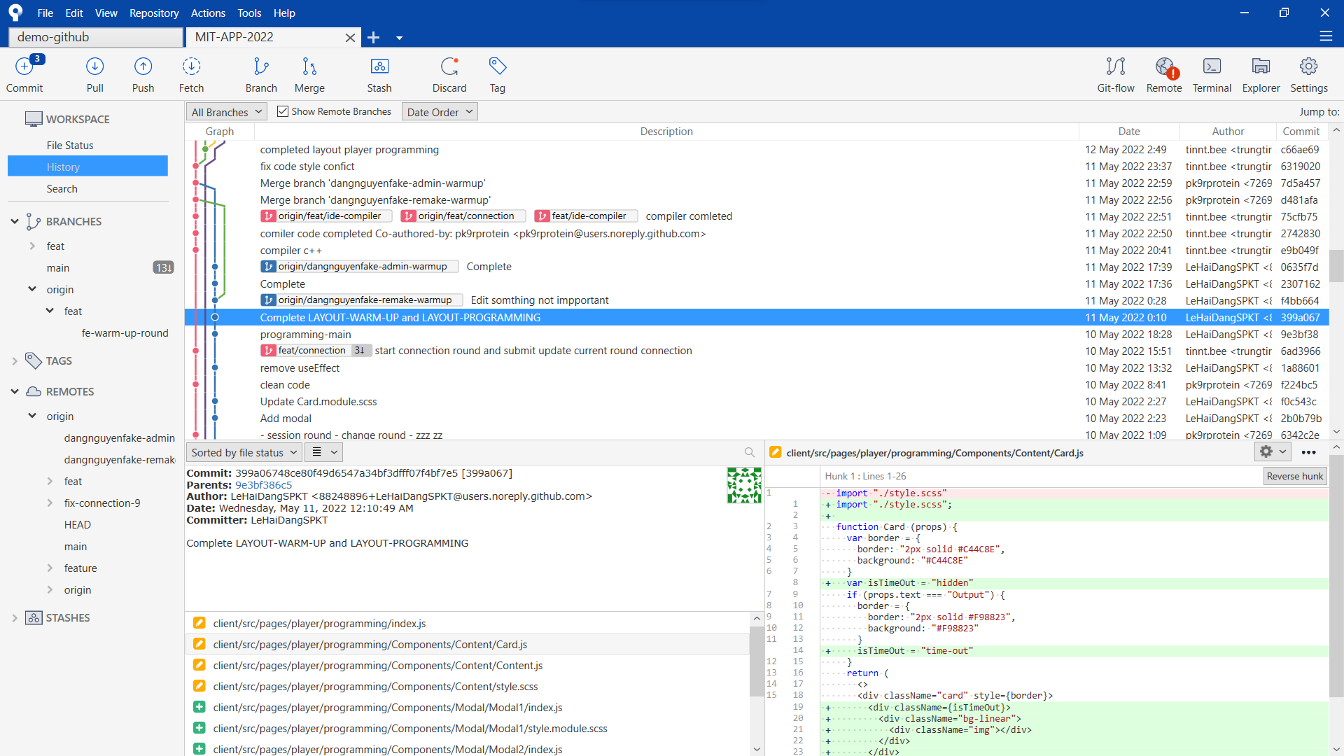
01
Get started with
SourceTree
Branch management
Common actions
Commits history
Commit detail
File changes detail

Slide 7

01
Get started with
SourceTree
PRACTICE
1. Setup & connect Github account
2. Branch
3. Fetch, Commit, Stash, Push & Pull
4. Rebase & resolve conflict
5. Search & Cherry-pick
Some tips

Slide 8
01
Get started with
SourceTree
02
Get started with
Git Kraken
03
Learn about some
VSC Git extensions

Slide 9
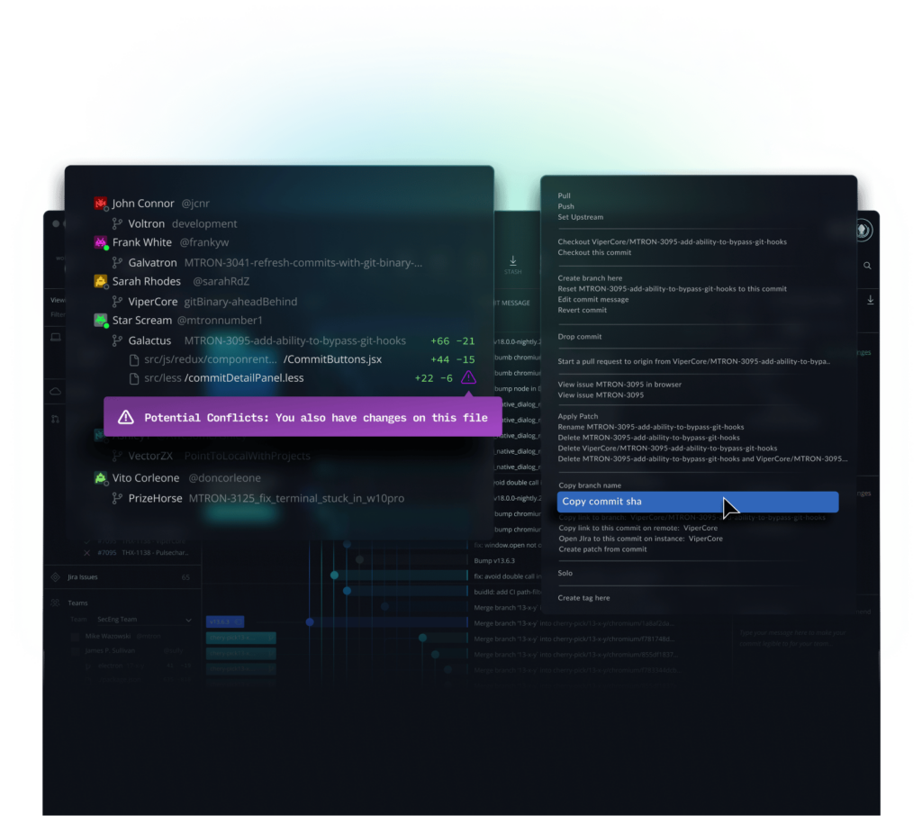

02
Get started with
Git Kraken
Information
Cross-platform support: Windows, Mac,…
Multi-Profiles & Customizable Views
User-friendly UI & Focus Workspaces
Terminal & Autocomplete suggestion
Strong visualize & Commit Graph, Tools,…
Easy to connect with Git hosting & issue
tracking tools: Jira, Trello,…

Slide 10
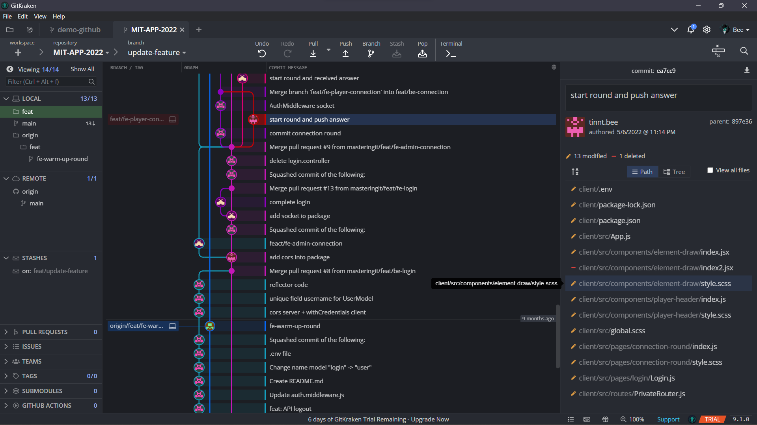
02
Get started with
Git Kraken
Branch management
Common actions
Commits history
Commit detail

Slide 11

02
Get started with
Git Kraken
Practice
1. Setup & create Profile
2. Commit, Stash, Push & Pull
3. Rebase & resolve conflict
4. Cherry-pick
5. More

Slide 12
01
Get started with
SourceTree
02
Get started with
Git Kraken
03
Learn about some
VSC Git extensions

Slide 13
Git History
Github Pull Requests & Issues
GitLens
Git Graph
Extensions
03
Learn about some
VSC Git extensions

Slide 14
GitHub
Q&A Session about
Fundamentals
Git GUI & Visual code Git extensions
Tin Nguyen Trung – tinnt.bee

